Slide 1
Group Theory
Haiyang Yu
01/14/2018

Slide 2
Outline
Historical origin of group theory
Number theory
Abstract (modern) algebra
Applications

Slide 3
Historical origin of group theory
9th century: junior algebra
16th century: cubic equation and fourth degree equation
18th century: Lagrange’s contributions
19th century: Galois theory
Abstract (modern) algebra

Slide 4
The concept of “algebra”
Arithmetic versus algebra
E.g. 5+7=12 (arithmetic); a+b=c (algebra)
Algebra is the abstract form of arithmetic
The word “algebra” comes from the name of a treatise of the mathematician and astronomer Mahommed ibn Musa al-Kharizmi (Mahommed, son of Musa, native of Kharizm) in the 9th century
His treatise on algebra was called “Al-jebr al-muqabala”, which means “transposition and removal”
Transposition (al-jebr): transfer of native terms to the other side of an equation
Removal (al-muqabala): cancellation of equal terms
The Arabic word “al-jebr” → “algebra” (Latin)

Slide 5
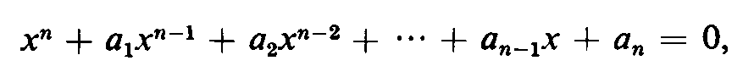
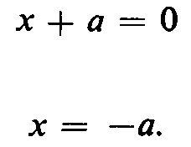
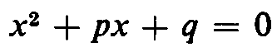
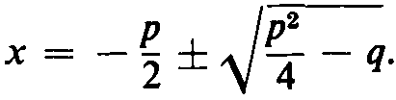
Linear and quadratic equations
Up to the 19th century, the majority of “algebra” had been dealing with equations, especially finding the roots of a polynomial equation:
First-degree
Second-degree

Slide 6
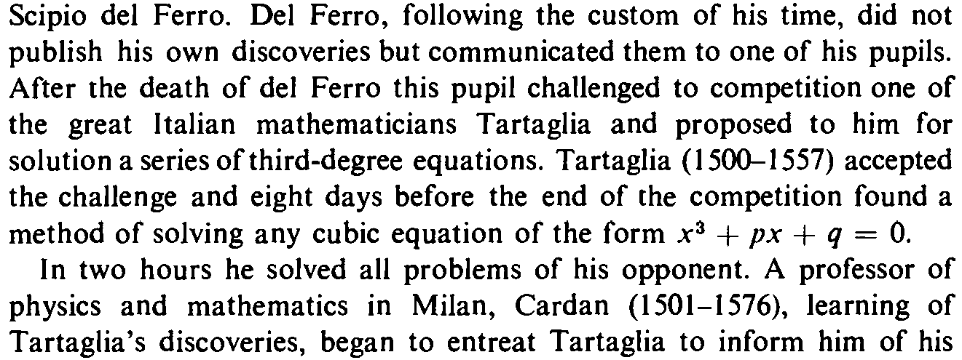
Third-degree (cubic) equation
Beginning of 16th century: in the era of the Renaissance, solved by the Italian mathematician Scipio del Ferro.
Then: Tartaglia (1500-1557), Cardan (1501-1576)

Slide 7
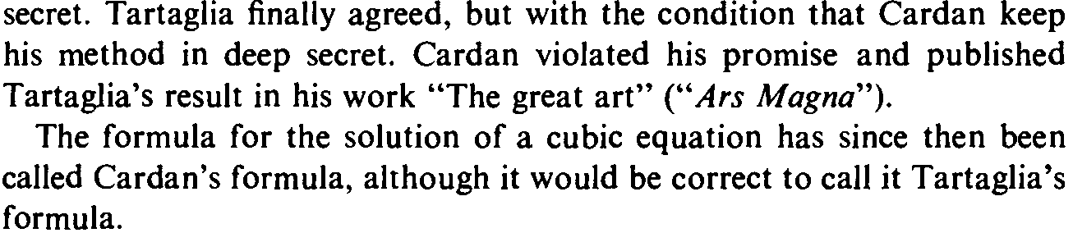
Third-degree (cubic) equation
Cardan’s formula

Slide 8
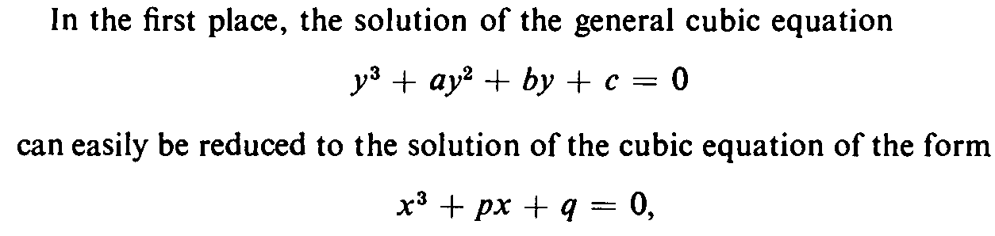
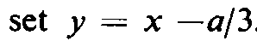
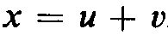
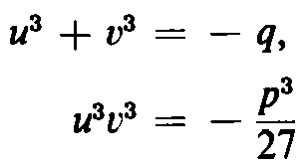
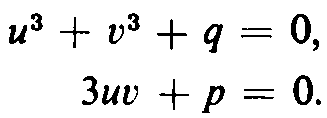
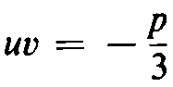
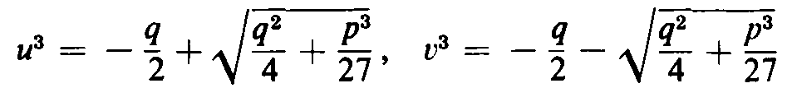
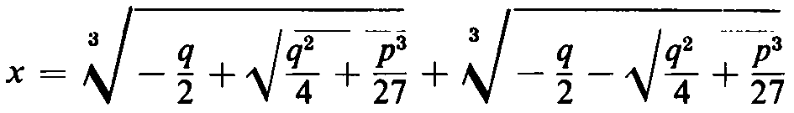
Hint:
Let:

Slide 9
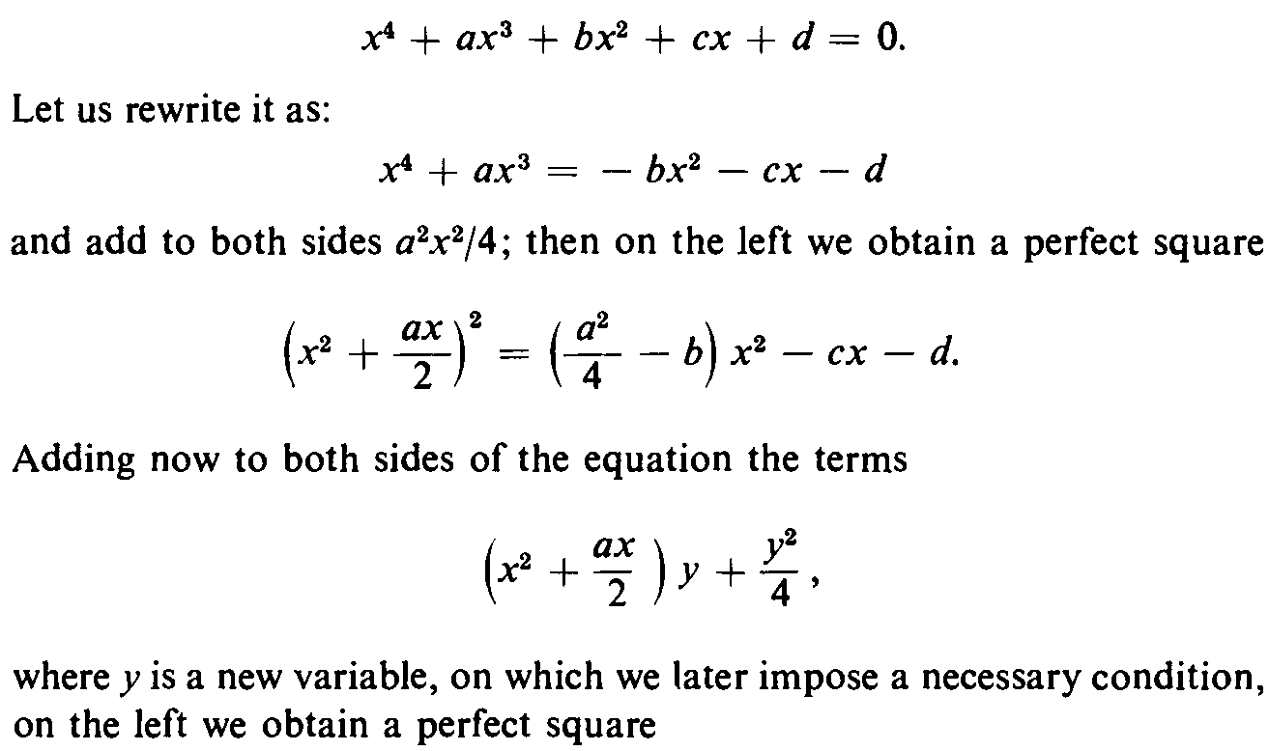
Fourth-degree equation
4-d equations were solved by Ferrari (1522-1565)

Slide 10
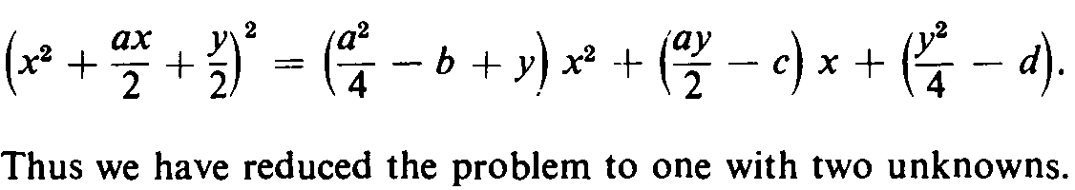
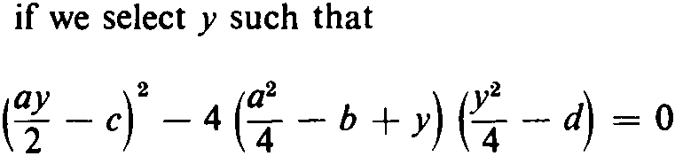
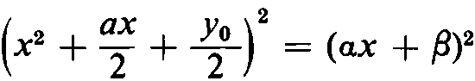
, which is a cubic equation of y that can be solved by Cardan’s formula:
Then, the right hand side of the original equation becomes a complete square form:
, where y0, alpha, beta are solved from the above cubic equation of y.

Slide 11
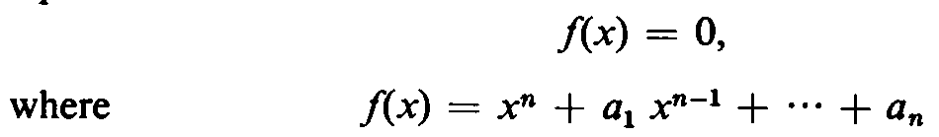
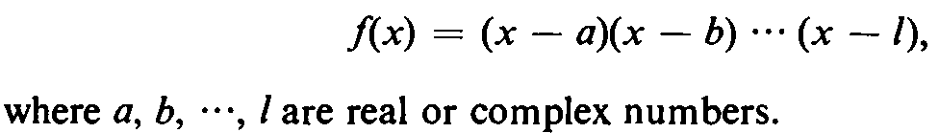
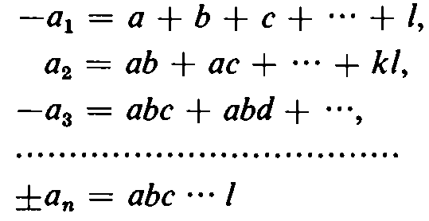
Viete’s formula
Short description: represent coefficients with roots rationally
Consider the general form:
Then, the polynomial f(x) can be represented (and in only one way) as:
(roots of the equation)
The order of roots doesn’t change the representing of coefficients: symmetric polynomials

Slide 12
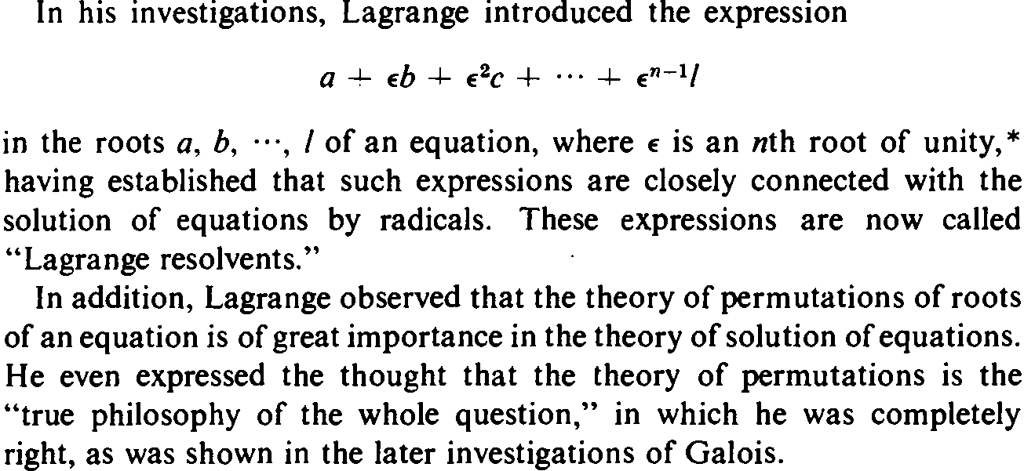
Lagrange resolvent
1770-1771: “Reflections on the solution of algebraic equations”

Slide 13
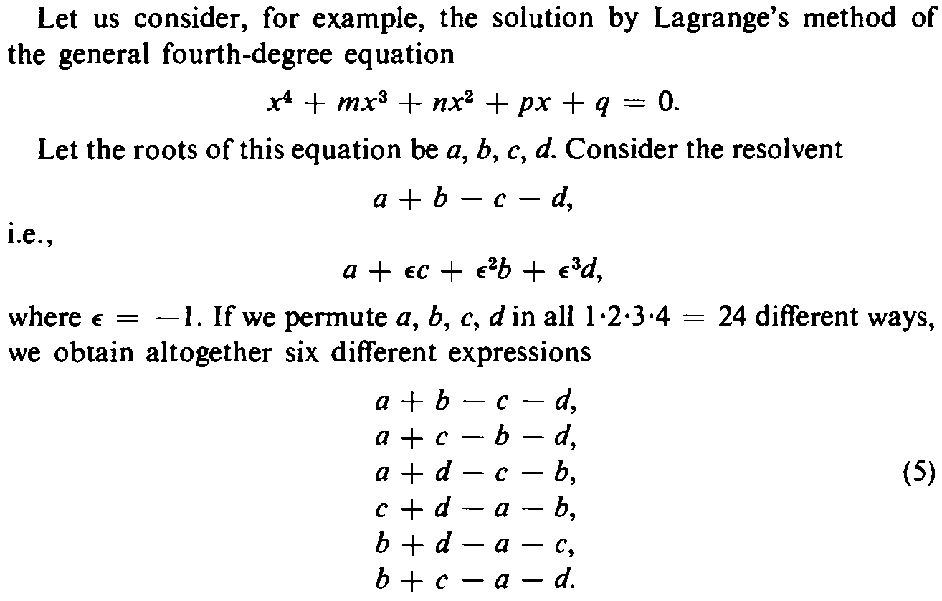

Slide 14
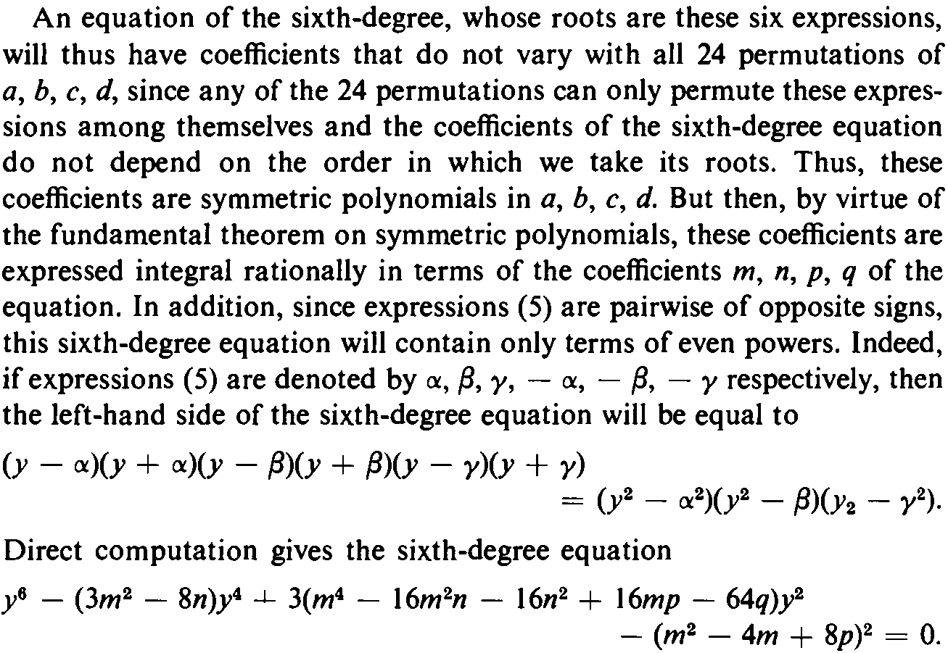

Slide 15
Coefficients Roots

Slide 16
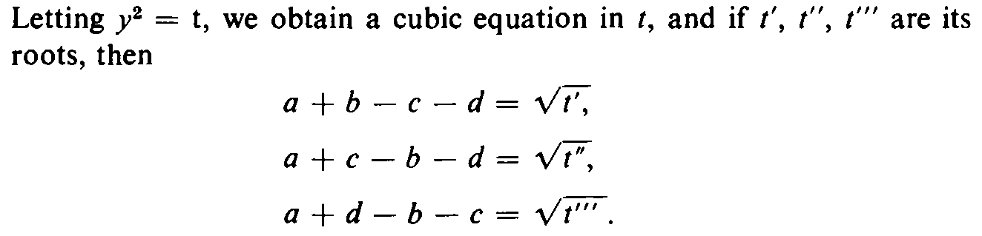
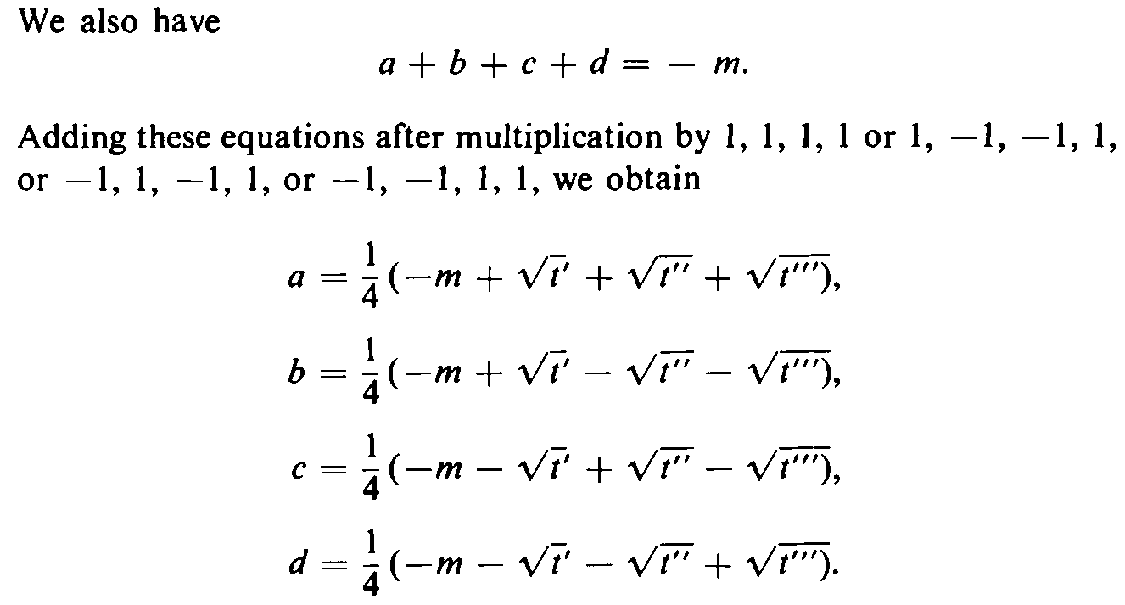

Slide 17
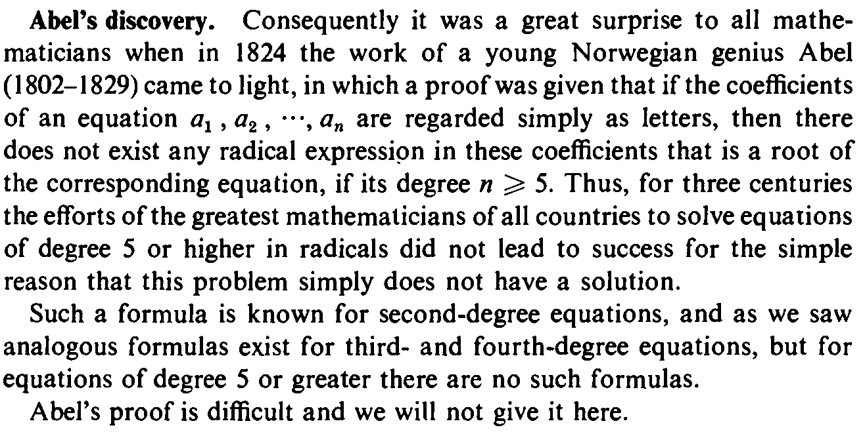
19th century
Abel (1802-1829)

Slide 18
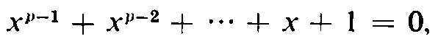
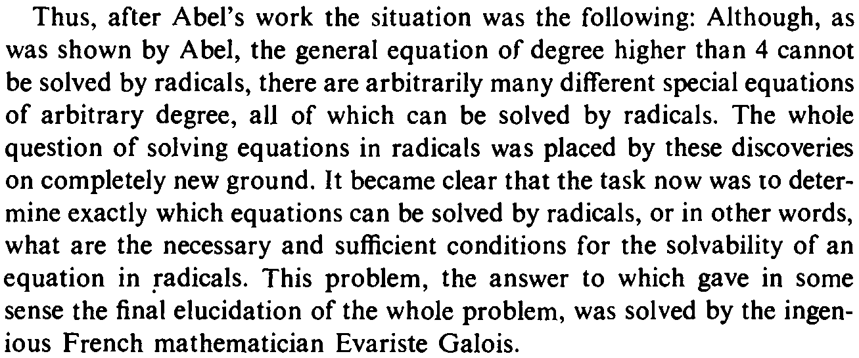
19th century
In face, there are many special equations that can be solved in radicals, which Abel couldn’t explain why, for example, Gauss proposed the “cyclotomic” equations (p is a prime number):

Slide 19
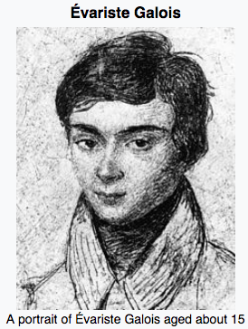
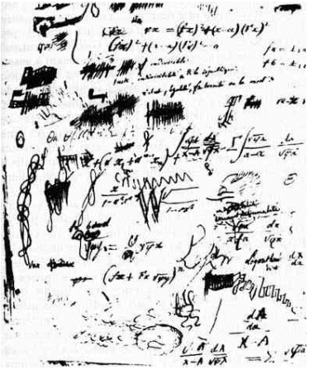
Galois (1811-1832) theory
https://en.wikipedia.org/wiki/%C3%89variste_Galois
Established group theory, concept of “field”
Connected the algebraic solution to a polynomial equation to the structure of a group of permutations associated with the roots of the polynomial, the Galois group of the polynomial
He found that an equation could be solved in radicals if one can find a series of subgroups of its Galois group, each one normal in its successor with Abelian quotient, or its Galois group is solvable

Slide 20
Abstract (modern) algebra
Axiomatization of algebra
Generalization of numbers
Integer → algebraic integer
Complex numbers → hyper-complex numbers, Klein four-group
Algebra v.s. geometry
Connection between “symmetries” of geometries and properties of groups → quantum mechanics, crystal theory
Vector space: transformation matrix with invariants (e.g. distance, area) → Klein geometries
Continuous groups, differential equations → Lie group, Lie algebra

Slide 21
Number theory
Divisibility, prime, gcd, lcm
Euclidean algorithm
Diophantine equation
Congruences and congruence equation
Chinese remainder theorem

Slide 22
Divisibility, prime, gcd, lcm
Let x and y are integers (x ≠ 0), if y/x is an integer, then we say:
x divides y
y is divisible by x
x is a divisor or factor of y
y is a multiple of x
Prime number: the only positive divisors are 1 and itself
Composite: not prime number

Slide 23
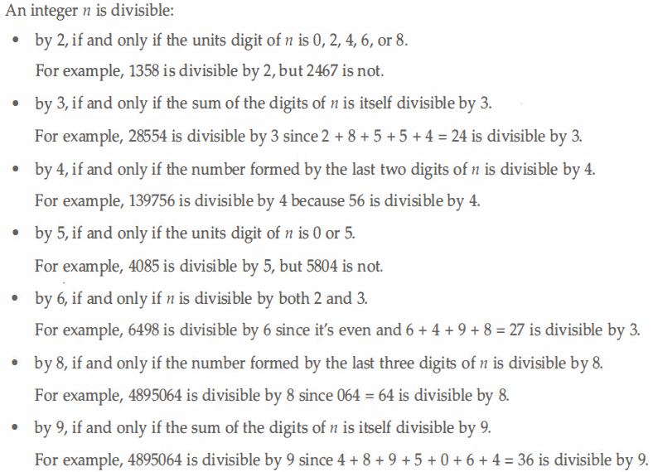

Slide 24
Relatively prime (or coprime): if the only positive divisor they have in common is 1.
Division algorithm: if x and y are positive integers (a≠0), then we can find unique integers q and r such that:
y = q*x + r, where 0 ≤ r < x
Here, we call q the quotient and r the remainder
Fundamental theorem of arithmetic: every integer n>1 can be expressed as a unique product of primes.
E.g. 3960 = 2³ * 3² * 5 * 11
The great common divisor (gcd) and the least common multiple (lcm)

Slide 25
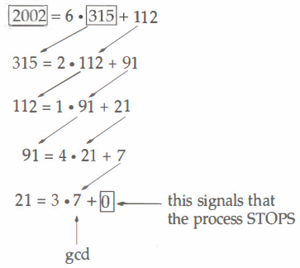
Euclidean algorithm
What is the great common divisor of 2002 and 315?

Slide 26
The Diophantine equation
a*x + b*y = c
All the variables are restricted to integers
E.g. x+2y = 3, what are the integer solutions?
Ans: one solution is (1, 1), the general solutions are: (1+2t, 1-t)
Requirement: gcd(a,b) should divide c, otherwise there will be no integral solution
Fermat’s last theorem: x^{n} + y^{n} = z^{n}, if the integer n>2, this equation has no solutions in nonzero integers x, y, and z.
How to solve a linear Diophantine equation: ax + by = c?
1. Find one solution: (x₀, y₀)
2. Get the general solutions: ( x0 + (b/d)t, y0 - (a/d)t ), where d is gcd(a, b), t is any integer.
Qu: gcd(a, b) is easy to find, but how to find one solution (x₀, y₀)?

Slide 27
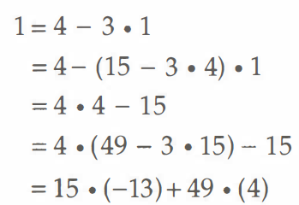
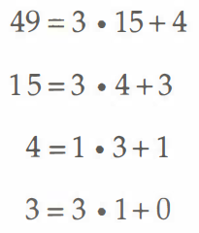
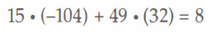
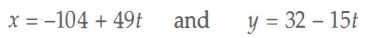
The Diophantine equation
Let consider an example: 15x + 49y = 8
gcd(15, 49) = 1, which divides 8, so this equation has infinite integral solutions
Euclidean algorithm
gcd(15,49)

Slide 28
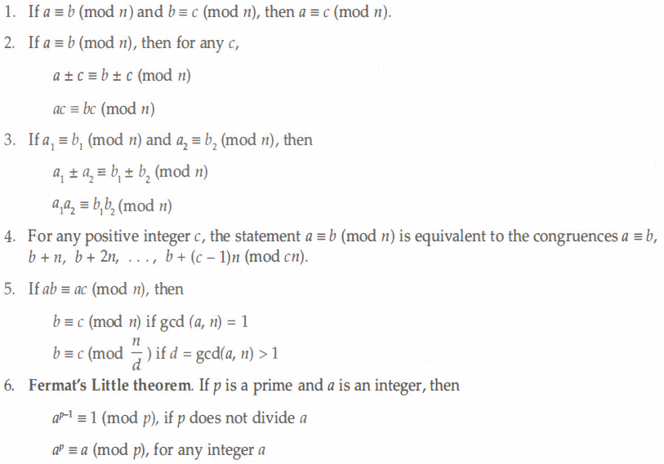
Congruences
a ≡ b (mod n): a is congruent to b modulo n if a-b is divisible by n

Slide 29
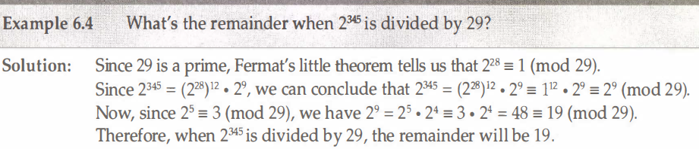

Slide 30
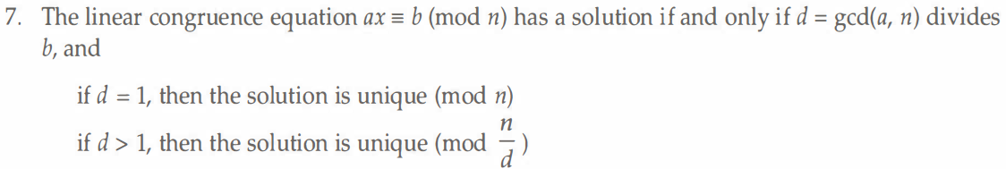
The congruence equation
ax ≡ b (mod n), where a≠0
E.g. 2x ≡ 5 (mod 6) has no solution
Algorithm 1: ax ≡ b (mod n) can be reduced into a linear Diophantine equation a*x – n*k = b, where k is an integer, which is solvable.
Algorithm 2: recursive method

Slide 31
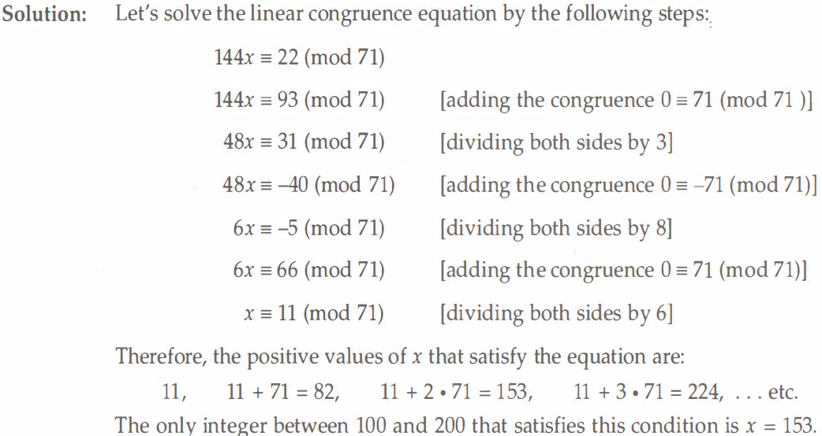

Slide 32
Chinese remainder theorem
The earliest known statement of the theorem, as a problem with specific numbers, appears in the 3rd century book Sunzi Suanjing by the Chinese mathematician Sunzi:
“There are certain things whose number is unknown. If we count them by threes, we have two left over; by fives, we have three left over; and by sevens, two are left over. How many things are there?”
In mathematical language, it is:
x ≡ 2 (mod 3)
x ≡ 3 (mod 5)
x ≡ 2 (mod 7)
What is the solution of x?

Slide 33
HW: how to tell if the solutions exist for a given set of equations?

Slide 34
Abstract (modern) algebra
Group, semi-group, monoid, Abelian group
Cyclic groups
Subgroups, cyclic subgroups, generators
Isomorphism
Finite Abelian groups
Homomorphism
Equivalence, conjugation
Normal subgroup, coset, quotient group
Rings
Fields

Slide 35
Definitions
A set G together with a binary operation * defined on it is called a group with respect to this operation (G, *) if the following group axioms are satisfied:
1. Closure: for any x, y in G, x*y is still in G;
2. Associativity: for any x, y, z in G, we have
x*(y*z) = (x*y)*z;
3. Identity: there exists an element e in G such that for every x in G, we have
x*e = e*x = x;
4. Invertibility: for every x in G, there exists an element x⁻¹ in G such that
x*x⁻¹ = x⁻¹*x = e.
Finite group v.s. infinite group: order of a group
Abelian group:
For any x, y in a group (G, *) (usually just written as G), if x*y = y*x (commutative), this group is called Abelian group.

Slide 36
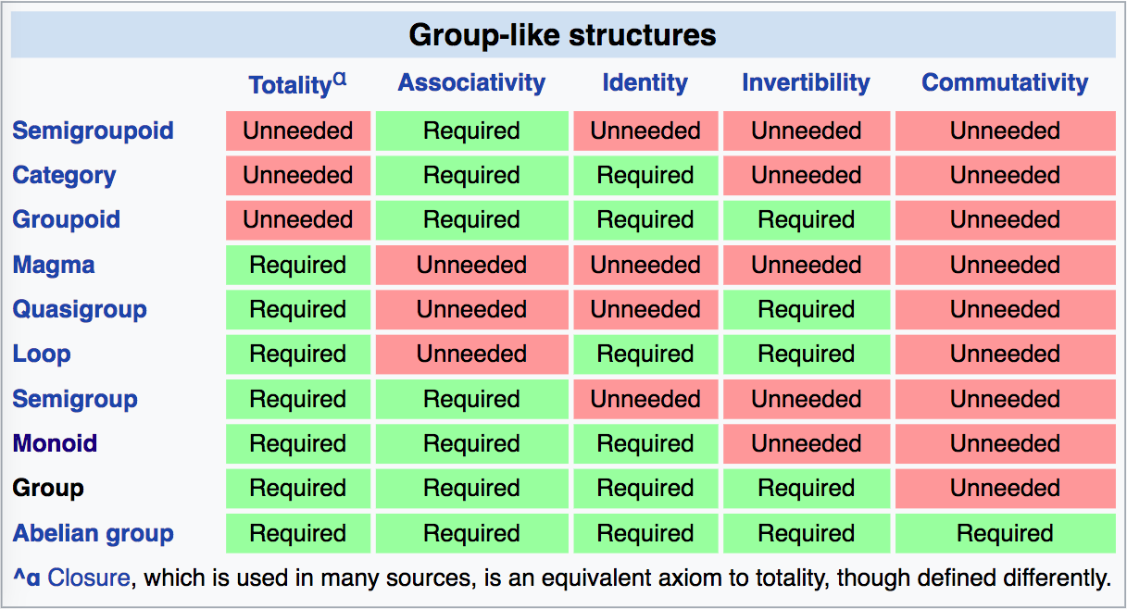

Slide 37
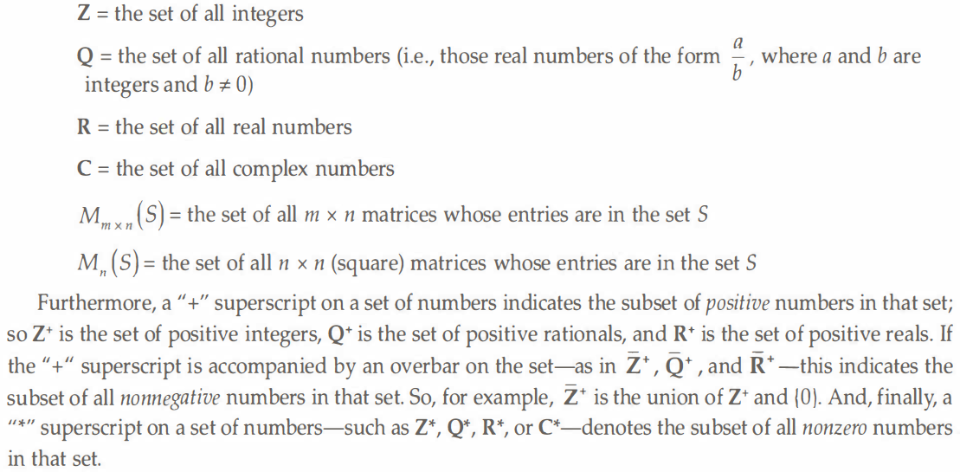
Some notations

Slide 38
Examples
Z⁺ is closed for addition +, but not closed for subtraction -;
(Z*, ×) is not a group, but (Q*, ×) is a group
Typical infinite Abelian groups:
(Z, +), (Q, +), (R, +), (C, +), (Q*, ×), (R*, ×), (C*, ×)
(M_{m×n}(S), +) and (M_{n}(S), +), where S in Z, Q, R, or C.
General linear group GL(n, R):
Subset of M_{n}(R) that consists of all invertable n×n matrices with entries in R (or Q, C)
Special linear group SL(n, R):
Subset of GL(n, R), but with determinant being 1.
The closure is easily tested: det(AB) = det(A)det(B)
Group of n^{th} roots of unity: U_{n} = {z: z^{n} = 1}, z is in C;

Slide 39
Permutation group: symmetric group on n letters S_{n}:
All the permutations (bijective mapping) from the set {1, 2, …, n} to itself; obviously, the order of S_{n} is n!
For every n>=3, S_{n} is a non-Abelian group
Group multiplication table
S₃ | e | (1,2) | (1,3) | (2,3) | (1,2,3) | (1,3,2)
e | e | (1,2) | (1,3) | (2,3) | (1,2,3) | (1,3,2)
(1,2) | (1,2) | e | (1,2,3) | (1,3,2) | (1,3) | (2,3)
(1,3) | (1,3) | (1,3,2) | e | (1,2,3) | (2,3) | (1,2)
(2,3) | (2,3) | (1,2,3) | (1,3,2) | e | (1,2) | (1,3)
(1,2,3) | (1,2,3) | (2,3) | (1,2) | (1,3) | (1,3,2) | e
(1,3,2) | (1,3,2) | (1,3) | (2,3) | (1,2) | e | (1,2,3)

Slide 40
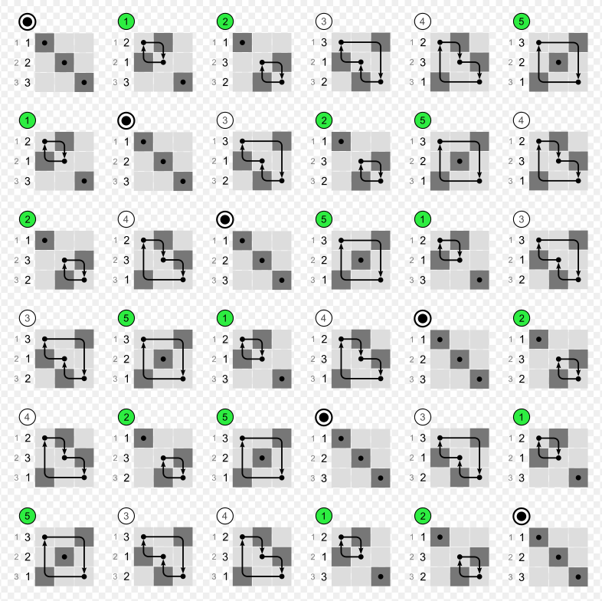

Slide 41

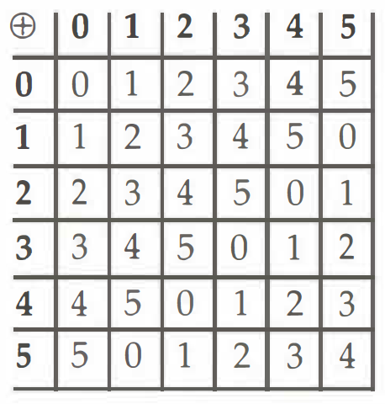
Additive group of integers modulo n (Z_{n}, ⨁):
For any two integers x and y in Z_{n}, define a⨁b to be the remainder of a+b being divided by n;
It is a finite Abelian group of order n.

Slide 42
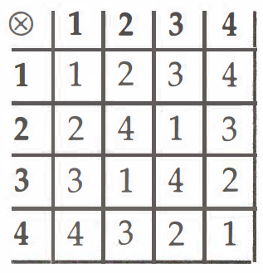
Multiplicative group of integers modulo p (Z*_{p}, ⨂)
Z*_{p}: set of integers modulo p except 0
p should be a prime number, otherwise, some elements will have no inverse.
Group table for (Z*₅, ⨂)

Slide 43
Cyclic groups
If there exists an element a in a group (G, *) such that
G = {a^{n}: n=0,1,2,…}
we call this group is cyclic, and the element a is a generator of the group, where a⁰=e, a^{n} = a^{n-1} * a.
There could be more than one generator in one group, for example, U₄ = {1, i, -1, -i} have two generator i and –i;
Theorem: the integer m is a generator of (Z_{n}, ⨁) if and only if m is relatively prime to n.
E.g. (Z_{n}, ⨁) is generated by 1 and 5, but not 2, 3, 4.
Theorem: if a is a generator of group G with order n, then the element a^{m} is also a generator of G if and only if m is relatively prime to n.
E.g. for U₄, i is a generator, i³ = -i is also a generator.

Slide 44
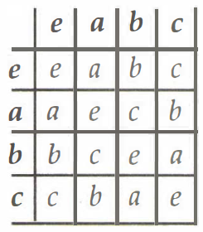
Theorem: every cyclic group is Abelian, but not every Abelian group is cyclic.
Proof: let a is a generator, then a^{m} * a^{n} = a^{m+n} = a^{n} * a^{m}
E.g. Klein four-group V₄: it is an Abelian group, but not cyclic (no generator exist)

Slide 45
Subgroups, cyclic subgroups
Let (G, *) is a group, if there exists a subset H of G such that (H, *) is also a group, then H is a subgroup of G.
E.g. {e} and G itself are subgroups of G
E.g. {e, a}, {e, b}, {e, c} are subgroups of Klein four-group V₄
E.g. {e, (1,2,3), (1,3,2)} is a subgroup of S₃
E.g. {0, 3}, {0, 2, 4} are subgroups of (Z₆, ⨁)
For an element a in a group G, if the set 〈a〉 = {a^{n}: n∊Z} that consists all the integer power of a is a subset of G, then we call 〈a〉 a cyclic subgroup of G generated by a.
E.g. 〈4〉 = {0, 2, 4} is a cyclic subgroup of (Z₆, ⨁)
E.g. 〈a〉 = {e, a} is a cyclic subgroup of Klein four-group V₄
A group G that can be generated by a finite set is said to be finitely generated.
E.g. Klein four-group V₄ can be generated by any of these two-element sets: {a, b}, {a, c}, or {b, c}

Slide 46
Langrange’s theorem: a group’s order is dividable by the its subgroups’ order.
E.g. group V₄ has order 4, and all of its subgroups: {e}, {e, a}, {e, b}, {e, c}, V₄ itself have order 1, 2, 4, which all divide 4;
E.g. (Z₆, ⨁) has order 6, all subgroups: {0}, {0, 3}, {0, 2, 4}, and (Z₆, ⨁) itself have order 1, 2, 3, 6, which all divide 6;
E.g. S₃ has order 6, all subgroups: {e}, {e, (1,2)}, {e, (1,3)}, {e, (2,3)}, {e, (1,2,3), (1,3,2)}, S₃ itself have order 1,2,3,6 dividing 6.
Theorem of existence: a finite Abelian group with order n has at least one subgroup for each (positive) divisor of n.
Theorem of unique: a finite cyclic group with order n has exact one subgroup for each divisor of n.
Cauchy’s theorem: a finite group with order n has at least one subgroup of order p, which is a prime that divides n.
Sylow’s first theorem: for a finite group with order n=p^{k}m, where p is a prime that does not divide m, it has at least one subgroup of order p^{i} for every integer i from 0 to k.

Slide 47
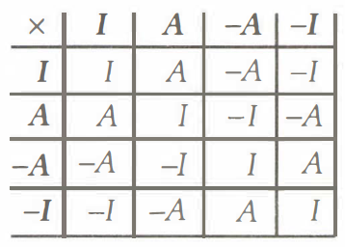
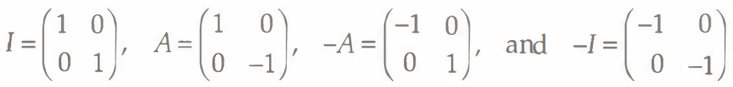
Isomorphism
Two groups are isomorphism (G1 ≅ G2) if they are structurally identical: there exists a full bijective mapping between G₁ and G₂ which maintains the operations.
E.g. (Z₄, ⨁), (Z*₅, ⨂), and V₄ are nonisomorphic for each pair;
E.g. (Z₆, ⨁) and S₃ are nonisomorphic
E.g. U₃ and (Z₃, ⨁) are isomorphic
E.g. V4 is isomorphic to M, which is a subgroup of (M₂(Z), ×) that is consists of four matrices:

Slide 48
Classification of finite Abelian groups
For two groups (G₁, *₁) and (G₂, *₂), the direct product of them (G₁×G₂, *) is also a group, where:
G₁×G₂ = {(a, b): a∊G₁, b∊G₂}
(x₁, x₂) * (y₁, y₂) = (x₁*₁y₁, x₂*₂y₂)
If G₁ and G₂ are finite groups, and their orders are m and n, then G₁×G₂ has order mn.
If G₁ and G₂ are both Abelian, then the resulting (Abelian) group is called the direct sum of G₁ and G₂, written as G₁⨁G₂.
Theorem: if gcd(m,n)=1, then Z_{m}⨁Z_{n} is cyclic and isomorphic to Z_{mn}.
E.g. Z₂⨁Z₄ is not cyclic, but Z₂⨁Z₃ is cyclic and Z₂⨁Z₃≅Z₆
Generalized theorem: Z_{m1}⨁Z_{m2}⨁ … ⨁Z_{mk} is cyclic if and only if gcd(m_{i}, m_{j})=1 for every distinct pair m_{i} and m_{j}, and Z_{m1}⨁Z_{m2}⨁ … ⨁Z_{mk}≅Z_{m1m2…mk}

Slide 49
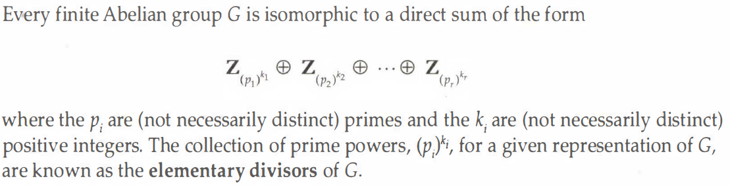


Slide 50



Slide 51


Slide 52


Slide 53
Homomorphism
Let (G, •) and (G’, *) being groups, a function ϕ: G→G’ with the property that
ϕ(x • y) = ϕ(x) * ϕ(y)
For all the elements x and y in G, is called a group homomorphism.
Monomorphism: one-to-one (injective) mapping
Epimorphism: onto (surjective) mapping
Isomorphism: one-to-one and onto (bijective) mapping
Endomorphism: a homomorphism from a group to itself
Automorphism: an isomorphism from a group to itself
https://en.wikipedia.org/wiki/Bijection,_injection_and_surjection

Slide 54



Slide 55



Slide 56


Slide 57


Slide 58


Slide 59


Slide 60
Equivalence relation and equivalence class
A given binary relation ~ on a set X is said to be an equivalence relation if and only if it is reflexive, symmetric and transitive. That is, for all a, b and c in X:
a ~ a. (Reflexivity)
a ~ b if and only if b ~ a. (Symmetry)
if a ~ b and b ~ c then a ~ c. (Transitivity)
X together with the relation ~ is called a setoid. The equivalence class of a under ~, denoted [a], is defined as [a]={b: b~a, b∊X}
Examples:
Let the set {a,b,c} have the equivalence relation
{(a,a), (b,b), (c,c), (b,c), (c,b)}.
All the equivalence classes : [a]={a}, [b]=[c]={b,c}
Under this equivalence relation, there exist an unique partition of X: { {a}, {b,c} }.

Slide 61
The following are all equivalence relations:
"Has the same birthday as" on the set of all people.
"Is similar to" on the set of all triangles.
"Is congruent to" on the set of all triangles.
"Is congruent to, modulo n" on the integers.
"Has the same image under a function" on the elements of the domain of the function.
"Has the same absolute value" on the set of real numbers
"Has the same cosine" on the set of all angles.
Some relations that are not equivalence
E.g. The relation "≥" between real numbers is reflexive and transitive, but not symmetric. For example, 7 ≥ 5 does not imply that 5 ≥ 7.

Slide 62
Quotient set
Given a set S and an equivalence relation ~ on S, all the equivalence classes form a partition of S (i.e. a set of set), which is also called quotient set or the quotient space of S by ~ and is denoted by S / ~.
Every two equivalence classes are either equal or disjoint.
Examples:
Let X = R² be the standard Cartesian plane, and let Y be a line through the origin in X. Then the quotient space X/Y can be identified with the space of all lines in X which are parallel to Y. That is to say that, the elements of the set X/Y are lines in X parallel to Y. This gives one way in which to visualize quotient spaces geometrically.
Another example is the quotient of R^{n} by the subspace spanned by the first m standard basis vectors. Two vectors of R^{n} are in the same congruence class modulo the subspace if and only if they are identical in the last n−m coordinates. The quotient space R^{n}/ R^{m} is isomorphic to R^{n−m.}
More generally, if V is an (internal) direct sum of subspaces U and W: V=U⨁W, then the quotient space V/U is isomorphic to W.

Slide 63
Conjugate
Let G be a group. Two elements a and b of G are conjugate, if there exists an element g in G such that gag⁻¹ = b (or ga = bg).
If b is a conjugate of a, then a is also a conjugate of b. (proof: b = gag⁻¹, a = g⁻¹bg)
Every element is conjugate to itself. (proof: aa⁻¹ = a⁻¹a = e)
If a is a conjugate of b, and b is a conjugate of c, then a is also a conjugate of c. (proof: b = x⁻¹ax, c = y⁻¹by, so c = (xy)⁻¹a(xy))
So an element can have multiple conjugates. We can put all of them together as a set, which is named the conjugacy class of a. Therefore conjugation results in a partition of a group.
In the case of the group GL(n) of invertible matrices, the conjugacy relation is called matrix similarity.

Slide 64
Conjugacy class
Let G be a group and a is an element, the set that is consisted by all the conjugates of a is called the conjugacy class of a, denoted as Cl(a) = { b ∈ G | there exists g ∈ G with b = gag⁻¹ }
Cl(e)= {e}
If G is Abelian, then gag⁻¹ = a for all a and g in G; so Cl(a) = {a} for all a in G.
Examples
Symmetric group S₃ has three conjugacy classes: {e}, {(1,2), (1,3), (2,3)}, {(1,2,3), (1,3,2)}
S₄ has five conjugacy classes: {e}, (2), (3), (4), (2)(2)

Slide 65


Slide 66

Normal subgroup
A normal subgroup (or called invariant subgroup) is a subgroup which is invariant under conjugation by members of the group of which it is a part.
In other words, a subgroup H of a group G is normal in G if and only if gH = Hg for all g in G;
i.e., the sets of left coset and right coset of any g∈G coincide (gH = Hg);
Normal subgroups (and only normal subgroups) can be used to construct quotient groups from a given group;
Évariste Galois was the first to realize the importance of the existence of normal subgroups.

Slide 67
The image of conjugation of N by any element of G is N: ∀g ∈ G, gNg⁻¹ = N.
Any two elements commute regarding the normal subgroup membership relation: ∀g, h ∈ G, gh ∈ N ⇔ hg ∈ N.
The subgroup {e} consisting of just the identity element of G and G itself are always normal subgroups of G. The former is called the trivial subgroup, and if these are the only normal subgroups, then G is said to be simple.
All subgroups, N, of an abelian group, G, are normal, because gN = Ng. A group that is not abelian but for which every subgroup is normal is called a Hamiltonian group.
The translation group in any dimension is a normal subgroup of the Euclidean group (with the orthogonal group as the quotient group); for example in 3D rotating, translating, and rotating back results in only translation
The largest subgroup of H that is normal in G is called the core of H in G.
Examples:
S3 has four non-trivial subgroups: {e, (1,2)}, {e, (1,3)}, {e, (2,3)}, {e, (1,2,3), (1,3,2)}, but only the last one is a normal subgroup.

Slide 68
Coset
if G is a group, and H is a subgroup of G, and g is an element of G, then
gH = { gh : h∈H } is the left coset of H in G with respect to g
Hg = { hg : h∈H } is the right coset of H in G with respect to g.
Although derived from a subgroup, cosets are not usually themselves subgroups of G, only subsets.
In other words, if a subgroup H is the same as its conjugate subgroup gHg⁻¹, then H is called normal.
The cosets form a group called the quotient group or factor group.
Examples
Z₈ has two non-trivial subgroups: {0, 4}, {0,2,4,6}. Left cosets of {0,4} are {0,4}, {1,5}, {2,6}, {3,7}; left cosets of {0,2,4,6} are {0,2,4,6}, {1,3,5,7}. Both of {0,4} and {0,2,4,6} are normal subgroups

Slide 69
Quotient group
Let N be a normal subgroup of a group G. We define the set G/N to be the set of all left cosets of N in G, i.e., G/N = { aN : a ∈ G }, then the set G/N together with the multiplication operation on sets (i.e. subsets in G) forms a group, called quotient group.
The key: if N is a normal subgroup, the multiplication of its left cosets satisfies closure, associativity, identity, inversibility (homomorphism)
Closure: (aN)(bN) = a(Nb)N = a(bN)N = (ab)NN = (ab)N
Identity and inversibility: (a⁻¹N)(aN) = a⁻¹aN = N
The importance: the study of group G is reduced to that of its normal group N and quotient group G/N.
Notice: they are not ordered sets
Example
Consider the group with addition modulo 6: G = {0, 1, 2, 3, 4, 5}.
Consider the subgroup N = {0, 3}, which is normal because G is Abelian. Then the set of (left) cosets is of size three:
G/N = { a+N : a ∈ G } = { {0, 3}, {1, 4}, {2, 5} } = { 0+N, 1+N, 2+N }
Consider another subgroup N = {0, 2, 4}, the quotient group becomes:
G/N = { {0, 2, 4}, {1, 3, 5} } = { 0+N, 1+N }

Slide 70
Center
In abstract algebra, the center of a group, G, is the set of elements that commute with every element of G. It is denoted Z(G), from German Zentrum, meaning center. In set-builder notation,
Z(G) = {z ∈ G ∣ ∀g ∈ G, zg = gz} .
The center is always a normal subgroup, Z(G) ⊲ G. As a subgroup, it is always characteristic, but is not necessarily fully characteristic. The quotient group, G / Z(G), is isomorphic to the inner automorphism group, Inn(G).
A group G is abelian if and only if Z(G) = G. At the other extreme, a group is said to be centerless if Z(G) is trivial; i.e., consists only of the identity element.
The elements of the center are sometimes called central.

Slide 71


Slide 72



Slide 73


Slide 74
Rings
A ring is a special binary structure with two binary operations
A set R with two binary operations (+ and •) is called a ring if the following conditions are satisfied:
(R, +) is an Abelian group
(R, •) is a semigroup (associativity)
Distributive law: for any a,b,c in R, we have
a•(b+c) = a•b + a•c (a+b)•c = a•c + b•c
A ring with unity: (R, •) is a monoid
Commutative ring: the multiplication is commutative
Subring: S is a subset of R and forms a ring (S, +, •)

Slide 75


Slide 76


Slide 77

Ring homomorphism
Let (R, +, ×), (R’, ⨁, ⨂) be rings, a function ϕ: R→R’ is called a ring homomorphism if both of the following conditions hold for every a and b in R:
ϕ(a+b) = ϕ(a) ⨁ ϕ(b)
ϕ(a×b) = ϕ(a) ⨂ ϕ(b)

Slide 78

Examples
The function ϕ: Z→Z_{n} given by ϕ(k) = the unique integer in Z_{n} that is congruent to k (mod n) is a ring homomorphism (actually, it is a ring epimorphism, because it is onto);

Slide 79


Slide 80

Integral domain
Integral domain: a commutative ring with unity (1≠0) that has no zero divisors.
E.g. In Z₆, we have 3*4=0, so Z₆ is not a integral domain
Cancellation law (a≠0 and ab=ac ➔ b=c) is only guaranteed in a integral domain

Slide 81


Fields
A commutative division ring is called a field

Slide 82


Slide 83


Slide 84
Applications
Kolmogorov probability theory
Error correcting codes
Klein four-group
Rubik’s Cube
Symmetric group
Symmetry group
Erlangen program
Galois Theory
Lie group and Lie algebra

Slide 85



Kolmogorov probability theory

Slide 86


homomorphism
B
0 1

Slide 87

Ordinary mapping

Slide 88
Error correcting codes
Problem: when information is transferred, some errors might be introduced due to the environmental noises, how to correct them when you receive the message?
Idea: add more data to constrain the information in certain mathematical structures and the receiver is able to detect and recover it;
GL(2): also F₂ or Z₂, is the Galois field of two elements. It is the smallest finite field.
Logical XOR
Logical AND
+ | 0 | 1
0 | 0 | 1
1 | 1 | 0
× | 0 | 1
0 | 0 | 0
1 | 0 | 1

Slide 89

Let’s consider an example of transferring a message X with 15 bits, i.e. x_{i} ∈ F₂, i=1,2,…,15.
Construct linear equations on F₂: HX = 0
The message is an element in the set of the general solutions of this linear system.
Now, suppose there is an error at the i^{th} bit in X (either 0 to 1 or 1 to 0), that is Y = X + e_{i}, then HY = HX + He_{i} = He_{i}.
If we carefully design H to make He_{i} having 15 distinct values corresponding to the e_{i}, then we can detect the error index i given He_{i}, and correct it by: X = Y + e_{i}.

Slide 90
Consider a message X = (1,1,1,1,1,1,1,1,1,1,1,1,1,1,1)^{T}, it is easy to prove that HX=0;
Add an error on 6th bit: Y = (1,1,1,1,1,0,1,1,1,1,1,1,1,1,1)^{T};
Then, HY = (0,1,1,0)^{T}, so the error is at the 6th bit, the correction is: X = Y + (0,0,0,0,0,1,0,0,0,0,0,0,0,0,0)^{T}
The rank of H is 4, but with 15 variables, so the solution set (space) is an 11 dimensional space on F₂ with 2¹¹ elements. In other words, there are only 11 free variables in this 15 bit message. These 11 bits contain information while the left 4 bits’ function is error correcting.

Slide 91
Klein four-group
V or K₄: the smallest non-cyclic group
V is an Abelian group
V is isomorphic to the direct product of Z₂: Z₂×Z₂
V is a normal subgroup of the alternating group A₄ (and also the symmetric group S₄) on four letters. In fact, it is the kernel of a surjective group homomorphism from S₄ to S₃: V = { (e), (1,2)(3,4), (1,3)(2,4), (1,4)(2,3) }
In music composition the four-group is the basic group of permutations in the twelve-tone technique.

Slide 92


Quaternion
Quaternions are a number system that extends the complex numbers. They were first described by Irish mathematician William Rowan Hamilton in 1843 and applied to mechanics in three-dimensional space.
Quaternions are generally represented in the form:
a + bi + cj + dk
where a, b, c, and d are real numbers, and i, j, and k are the fundamental quaternion units.

Slide 93

Quaternion group
The center and the commutator subgroup of Q₈ is the subgroup {e,e}.
The factor group Q₈/{e,e} is isomorphic to the Klein four-group V.
The inner automorphism group of Q₈ is isomorphic to Q₈ modulo its center, and is therefore also isomorphic to the Klein four-group.
The full automorphism group of Q₈ is isomorphic to the symmetric group of degree 4, S₄, the symmetric group on four letters.
The outer automorphism group of Q₈ is then S₄/V which is isomorphic to S₃.

Slide 94

Rubik’s cube
The breakthrough, known as "descent through nested
sub-groups" was found by Morwen Thistlethwaite;
details of Thistlethwaite's algorithm were published in
Scientific American in 1981 by Douglas Hofstadter.
The approaches to the cube that led to algorithms with very few moves are based on group theory and on extensive computer searches. Thistlethwaite's idea was to divide the problem into subproblems. Where algorithms up to that point divided the problem by looking at the parts of the cube that should remain fixed, he divided it by restricting the type of moves that could be executed. In particular he divided the cube group into the following chain of subgroups:
G₀ = 〈L, R, F, B, U, D〉
G₁ = 〈L, R, F, B, U², D²〉
G₂ = 〈L, R, F², B², U², D²〉
G₃ = 〈L², R², F², B², U², D²〉
G₄ = {e}
A random cube is in the general cube group G₀. Next he found this element in the right coset space G₁\G₀, et al.,

Slide 95
Symmetric group
S_{n} the group of all the permutation of n letters, so the order of S_{n} is n!;
The elements of the symmetric group on a set X are the permutations of X;
The group operation in a symmetric group is function composition (not commutative for n>2);
Transposition: permutation which exchanges two elements and keeps all others fixed
Every permutation can be written as a product of transpositions; for instance, the permutation (1 5 2)(3 4) can be written as g = (1 2)(2 5)(3 4)
Odd/even permutation: a permutation can be written as a product of an odd/even number of transpositions (not unique)
Sign of a permutation: +1 for even; -1 for odd (useful in calculating matrix determinant)
Sgn: S_{n} → {+1,-1} is a group homomorphism ({+1, –1} is a group under multiplication, where +1 is e, the neutral element)

Slide 96
Alternating group A_{n}: the kernel of the homomorphism Sgn: S_{n} → {+1,-1}, i.e. the set of all even permutations, is called the alternating group A_{n}. It is a normal subgroup of S_{n}, and for n ≥ 2 it has n!/2 elements;
Every permutation can be written as a product of adjacent transpositions, that is, transpositions of the form (a, a+1).
E.g. The sorting algorithm Bubble sort is an application of this fact. The representation of a permutation as a product of adjacent transpositions is also not unique.
The normal subgroups of the finite symmetric groups are well understood.
If n ≤ 2, Sn has at most 2 elements, and so has no nontrivial proper subgroups.
The alternating group of degree n is always a normal subgroup, a proper one for n ≥ 2 and nontrivial for n ≥ 3;
For n ≥ 3, A_{n} is in fact the only non-identity proper normal subgroup of Sn, except when n = 4 where there is one additional such normal subgroup, which is isomorphic to the Klein four group.
S₄ → S₃ corresponding to the exceptional normal subgroup V < A₄ < S₄;

Slide 97
Cayley's theorem states that every group G is isomorphic to a subgroup of the symmetric group on G.
Z₂ = {0,1} with addition modulo 2; group element 0 corresponds to the identity permutation e, group element 1 to permutation (12). E.g. 0 +1 = 1 and 1+1 = 0, so 1 -> 0 and 0 -> 1, as they would under a permutation.
Z₃ = {0,1,2} with addition modulo 3; group element 0 corresponds to the identity permutation e, group element 1 to permutation (123), and group element 2 to permutation (132). E.g. 1 + 1 = 2 corresponds to (123)(123)=(132).
Z₄ = {0,1,2,3} with addition modulo 4; the elements correspond to e, (1234), (13)(24), (1432). The elements of Klein four-group {e, a, b, c} correspond to e, (12)(34), (13)(24), and (14)(23).

Slide 98
Symmetry group
The symmetry group of an object (image, signal, etc.) is the group of all transformations under which the object is invariant with composition as the group operation.
2D case: Wallpaper groups
https://en.wikipedia.org/wiki/Wallpaper_group
Space groups in 3D (Fedorov groups or crystallographic groups):
https://en.wikipedia.org/wiki/Space_group

Slide 99
Erlangen program
Group action: https://en.wikipedia.org/wiki/Group_action
A mapping (function):
H × G → G
(h, g) → g ° m
is called a group action, if it satisfies identity and compatibility:
e°g = g; h₁°(h₂°g) = (h₁h₂) °g
Representation of group: actions of groups on vector spaces.
Orbit and invariant
E.g. Similar transformation is one kind of group action: GL_{n}(R) × M_{n}(R) → M_{n}(R); it doesn’t change the matrix’s trace and determinant:
If A = XDX⁻¹, where D is a diagonal matrix containing all the eigenvalues λ, then trace(A) = sum(λ);
Besides, det(A) = det(D) = product(λ)
https://en.wikipedia.org/wiki/Trace_(linear_algebra)
Klein geometry: https://en.wikipedia.org/wiki/Klein_geometry

Slide 100
Galois theory
At the level of groups of symmetries of zeroes, in order for an equation to be solvable by radicals, it has to have such a chain of subgroups (or called extended Fields):
G₁ ⊇ G₂ ⊇ … ⊇ G_{k} = E = {e}
with properties that
1) G_{i} is a normal subgroup of G_{i+1}, for every i=1,2,…,k-1;
2) The corresponding quotient group G_{i+1}/G_{i} is isomorphism to the cyclic group (i.e. x^{p}=c)

Slide 101
Example: x⁴+px²+q=0
The roots of this equation:
Denote R=Q(p, q) as the field (no forms of square root) of all radicals of p and q;
Then, there are only two relations:
x₁+x₂=0; x₃+x₄=0
The corresponding (normal) subgroup of the permutation group of roots is:
D₄ = {e, (12), (34), (12)(34), (13)(24), (14)(23), (1324), (1423)} ⊆ S₄

Slide 102
If we introduce variable w with the form of square root: w is a root in cyclic equation w²=p²-4q, then the field is extended as R’=R(w), which denotes the radicals using p, q and w=sqrt(p²-4q).
Then, one more relation occurs:
x₁² – x₃² = w
Corresponding normal subgroup:
K = {e, (12), (34), (12)(34)} ⊆ D₄

Slide 103
If we introduce one more variable u²=(-p-w)/2, then we have a new extended field R’’=R’(u), with the new relation:
x₃ – x₄ = 2u
The corresponding normal subgroup is:
Z₂ = {e, (12)} ⊆ K
Then, one more variable v² = (-p+w)/2, and extended field R’’’ = R’’(v), with the relation:
x₁ – x₂ = 2v
It is invariant only in the group E = {e} ⊆ Z₂
So the fields and subgroups chains are:
R’’(v) R’(u) R(w)
R’’’ ⊇ R’’ ⊇ R’ ⊇ R
E ⊆ Z₂ ⊆ K ⊆ D₄

Slide 104
Solve this linear system:
We can get the roots expressed as rational functions of coefficients of the original equation.

Slide 105
If n=5: S₅ ⊇ A₅ ⊇ E, unsolvable
Where E is the only normal subgroup of A₅, which is not cyclic.
If n=4: S₄ ⊇ A₄ ⊇ K ⊇ Z₂ ⊇ E, solvable
If n=3: S₃ ⊇ A₃ ⊇ Z₃ ⊇ E, solvable
If n=2: S₂ ⊇ E, solvable

Slide 106

Lie group and Lie algebra
Sophus Lie (1842-1899, Norwegian mathematician)
Galois group dealing with polynomial equations → Lie group dealing with differential equations
Algebraic equations: discrete symmetry, permutation groups
Differential equations: continuous symmetry, Lie groups
Examples
GL₂(R)
SL₂(R) or SO(2)
SO(3)
Matrix groups in GL(n):
SL(n): det(M)=1
Orthogonal matrix: M^{T}M = I

Slide 107
References
Steven A. Leduc: Cracking the GRE Mathematics Subject Test, 2nd edition. Chapter 6.
A. D. Aleksandrov, A. N. Kolmogorov, M. A. Lavrent’ev: Mathematics, its content, methods and meaning.
杨子胥：近世代数（第二版）
石明生：近世代数初步
Math history: https://www.youtube.com/watch?v=dW8Cy6WrO94&list=PL55C7C83781CF4316
Wikipedia

